Slide 1

Predicting NBA Playoff Teams
By: Nick Smailer
Notes:
Hi, I’m Nick Smailer, and my capstone project is focused on using historical data to determine whether or not basketball teams will reach the playoffs.

Slide 2
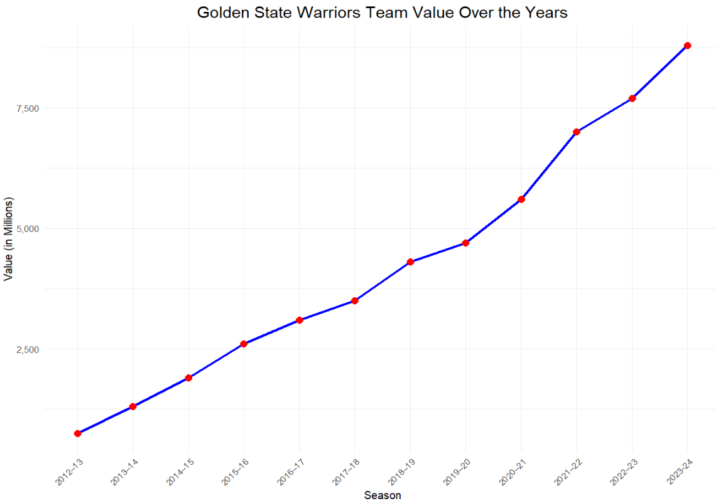
Problem context
The NBA is a professional basketball league in the United States
Some franchises are worth billions¹, yet there is no guarantee of success year over year
Franchises stand to dramatically increase revenue by making the playoffs, especially consistently
Players are paid up to roughly $50 million a year³, showing a significant investment into personnel
Considering the financial implications, it would be very advantageous to pinpoint what it takes to make the playoffs, from both a player and team standpoint
Notes:
The NBA stand for the National Basketball Association, which is the premier basketball league in the United States. There are 30 total teams, split between two conferences and each year 16 total teams make the playoffs. Additionally, 24 players, 12 from each conference are deemed as all-stars in a particular season. Some franchises are worth multiple billion dollars, and the best players make around $50 million dollars a year, yet it can still be unpredictable which teams will reach the postseason. Reaching the playoffs leads to an increase in revenue in a variety of ways. First, tickets and concessions are more expensive in the playoffs, increasing the profit margin compared to regular season games. More importantly, playoff appearance generates interest which expands viewership and increases fans across the country and the world. To put it simply, it pays to be popular. The Golden State Warriors are a case study on this- over the past 10 years their worth went from 555 million to almost 9 billion due to their dominance during that period. Taking these figures into account, it is clear that reliable predictions are required to determine whether or not teams will make the playoffs.

Slide 3
Research questions and goals
In order to predict what defines playoff teams, I set out to answer a handful of research questions which when answered comprehensively illuminate the full picture:
How do player statistics from the BEST teams compare to the WORST teams?
How many wins “guarantees” a playoff berth?
Can player statistics be used to predict a playoff berth?
Are TEAM statistics more indicative than PLAYER statistics?
Do advanced metrics provide better predictions than the standard categories (points, rebounds, assists, steals, blocks, shooting percentages)?
How much do ALL-STARS influence playoff appearance?
Notes:
In order to determine which teams will make the playoffs, I defined a few research questions which I believe illuminate the difference between playoff teams and non playoff teams and illustrate that YES, statistics can be reliably used to predict which teams will make the playoffs.

Slide 4
Data selection
The data used for this project was sourced from a Kaggle data repository³. Four separate datasets were used:
Player Totals
35 variables, 31,870 observations
Team Totals
31 variable, 1,845 observations
Team Stats Per Game
28 variable, 1,845 observations
All-Star Selections*
5 variables, 2,000 observations
Notes:
The data used for my project was obtained from a Kaggle repository containing many NBA datafiles. Four were used for my analysis. The player data totaled 35 variables with over thirty thousand observations, the team data files each had one eighteen hundred and fourty five records, with the totals dataset having 31 variables and the per game stats having 28 variables. Finally the all star data had 5 variables and 2000 observations, but only the all-star field was used
https://www.kaggle.com/datasets/sumitrodatta/nba-aba-baa-stats

Slide 5
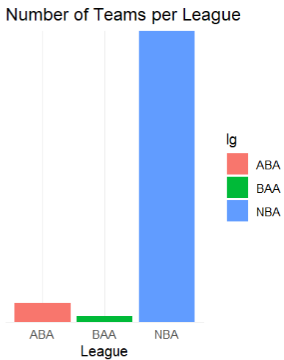
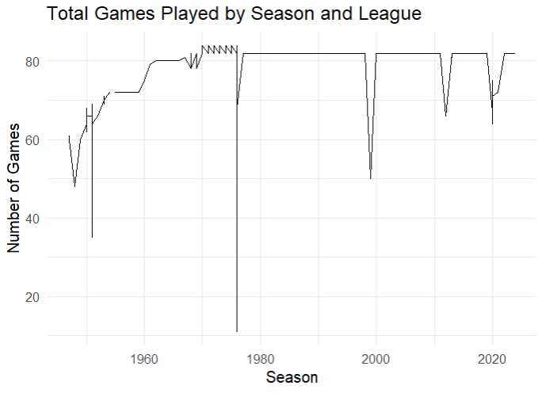
Data problems
Multiple leagues included- only examining NBA
Various season lengths- not conducive to predicting wins
League average rows with NAs
Tons of players who barely ever played
Field names repeated and inconsistent across datasets
3-point data
Inconsistent IDs
Notes:
Upon inspecting the data there were a handful of serious issues that needed to be addressed prior to analysis. Starting with the team data, there were irrelevant leagues included. The NBA is the only relevant basketball league in the United States, the others represented merged into the NBA over 50 years ago. Since the original data goes back to 1947, there are plenty of records for different leagues which needed removed. Next there were league average rows which had NA values and other problems, for example the league average is not a team.
Looking at the player dataset, there were countless records included for players who essentially never played. These could be players who were added to a roster, but did not get in games, players who sustained an injury forcing them to miss considerable time, or a variety of other reasons. Finally, issues that effected both datasets were the length of games in a season, inconsistent field names, and 3pt data. The varying number of games is a major issue, as it is akin to predicting against moving target from one year the next, there is no stability. Another issue was with 3-point data. The 3point line was introduced in 1979, so all years prior had 0s for all 3point statistics in both the player and team datasets. Additionally, some important names were inconsistent, for example the year were called season in one dataset and year in the other, the team initials (PHI or ATL) were called team name in one dataset and abbreviation in the other. Finally, the initial IDs were not as I desired. The season IDs numbered more than the actual count of seasons and both team and season id did not match in the player and team datasets. Finally, the player id was repetitive, each record having it’s own id rather than one player having their own id.
The images show the count of teams by league, with NBA dwarfing the other leagues and the game count over the years.
The season was set to 82 games in 1969, the years that dip after that are from seasons with contract strikes and then COVID

Slide 6
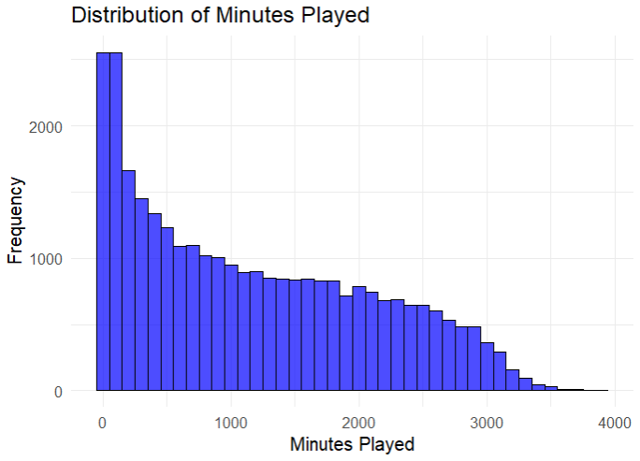
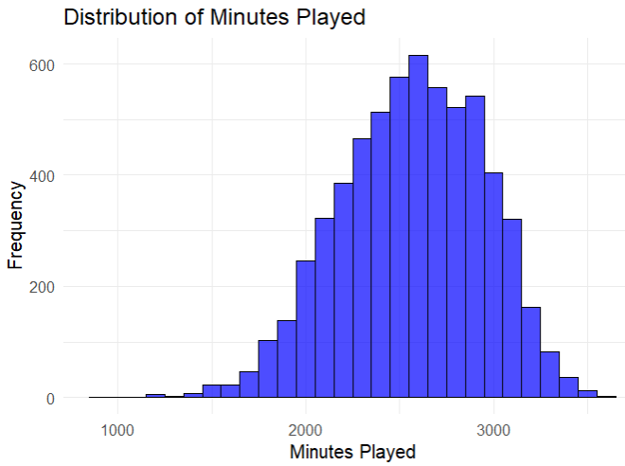
Data Transformation
IDs created
Player datasets joined
Player buckets created
All-star field added to player and team datasets
3-point adjusted
Predictive analytics subsets
Response transformation
Class standardization
Descriptive analytics subsets
Notes:
Having examined the data, I moved on to transforming the data in preparation for modeling. First, I used the season field to create a numerical ID for each year represented, ensuring consistency in each dataset. Then I did the same thing for the team ID using the team abbreviation. Finally in the player datasets I repeated the process using the players name. Even though the player and team data will be stored separately, maintaining consistency will effectively eliminate confusion.
Next, I joined the player datasets using the newly created IDs. Next, I eliminated all players below the original average for minutes played. As the chart shows, the data was skewed heavily to the left, and after my adjustment it shows a fairly normal distribution.Then, in the player dataset I created something I called player buckets. The player averages had large fluctuations between values, so I created buckets to standardize the data a little bit. For points per game players values range from 0 to almost 40 so, the buckets size was set at 5, meaning someone who averaged 0-5 points per game would be in bucket 1, 5-10 points would be in bucket 2, etc. the rest of the stats, the bucket size was 2, as averages do not exceed 20.
Next, in both datasets, I imputed the missing 3pt data using the first quartile value for the respective fields. I chose this because the 3pt performance was very poor when it was first added, making it reasonable to set a low end value for the missing values. I did not want to eliminate these fields or any more seasons leading me to this chohice.
Then, I added the all-star classification to the player data as a binary column. I was able to do this using the team and season ids which created previously. I also added an aggregation of all-stars to the team dataset for the total number of all-stars for each team for each year. Then I began creating subsets based on player averages or player buckets.
Since these fields stored the same information in different ways, modeling with them together would be redundant and I wanted to compare the accuracies with each. My initial modeling showed difficulty with the continuous response, so As a result, I converted the response variable (wins) to binary using a threshold of 42 games, then 50 games, one subset for each threshold for the team data and one for player buckets and player averages. These values will be explained later. I also created subsets containing only the top 5 players by minutes played for each team for each season, and the top 5 players for each team for each season positionally. My intent with the subset creation was to compare performance using different win thresholds, then to really drill down into the player data. The subsets introduced a new issue though, which was severe class imbalance. To treat this, I went through and determined the minimum class size for each subset, then standardized the data to have both classes be equal. This helped to mitigate bias towards the majority class that was seen in introductory modeling, as well.
I also created subsets for my descriptive analytics, but since there was no response variable, it was a bit simpler. I created a subset of playoff teams and non playoff teams, and I created a subset of “best players” and “worst players” made up of the top 5 players by minutes played from teams with wins above the third quartile value and below the first quartile value respectively. Finally, I created two subsets of the player data for all-stars and non-all-stars.
The images on the slide show the skewed distribution of minutes played before transformation, then the results post transformation.

Slide 7
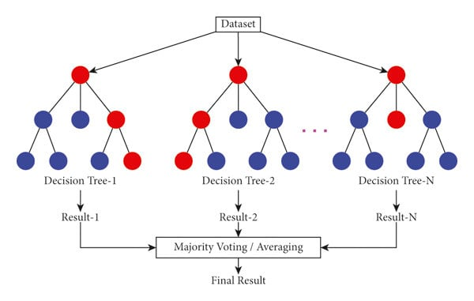
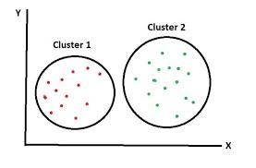
Models and performance measures
Early modeling included decision tree, linear regression, and random forest
Upon introducing binary response, logistic regression replaced linear regression
Random forest used most extensively for predictions
Validation methods
Mtry
Ntree
Node size
Accuracy
Precision
P-value
Kappa
K-means clustering used for pattern recognition
Silhouette Score
WCSS Distance
Centers examined for similarity and differences
Box plots for comparison
Notes:
During my initial predictive modeling, I used a variety of models, like the decision tree, linear regression, neural network, and random forest. Right away, I eliminated neural network due to run time and decision tree as random forest accomplishes the same thing.
After adjusting the response to binary, I also swapped the linear regression for a logistic regression. I modeled mostly with the logistic regression and random forest, leaning on the random forest heavily due to high accuracy and adaptability. When examining the linear and then logistic regression I was mainly concerned with the adjusted r squared value which shows how much of the variability in the response the data accounts for. I also examined the mean average error. the adjusted r square score clued me in that the models were struggling with the continuous response prompting the switch to binary.
The random forest were evaluated through a variety of metrics including the accuracy of classifications, the confidence interval, no information rate, p-value, and kappa. In order to improve the performance, I tested various values for mtry, number of trees, and node size. This was done for both the player and team data with each getting their own hyperparameter values. A metric not included is no information rate. This is because the no information rate is what clued me in to the bias in my initial models. Seeing the imbalance and resulting bias, I chose to standardize classes using the minority class size. As a result the no information rate is at a constant 0.5 for all models. Additionally, the p-value is very consistent in my models leading me to hold the confusion matrix and accuracy score in the highest regard. When training the models, I set a random seed for reproducibility and used a 75:25 split of training to test data.
In addition to the predictive analytics, I also conducted descriptive analytics using k-means clustering. My main goals with the cluster analysis were to determine patterns or major differences in opposite subsets of the data. By comparing the cluster results from the opposite subsets, it is possible to see where the impactful differences arise. In order to determine the ideal number of clusters I used the silhouette score and within cluster separation score. After completing the clustering, I compared centers and created boxplots to check the similarities and differences.

Slide 8
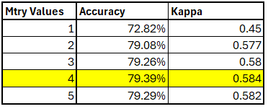
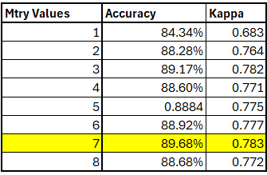
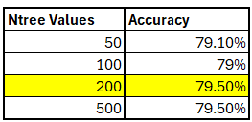
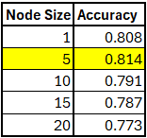
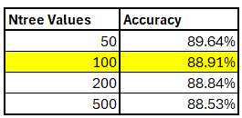
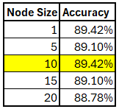
Random forest parameters
Player parameters Team Parameters
Notes:
Considering my goal was to compare performance using different data- team and player, then subsets of the player data, I decided to focus almost exclusively on the random forest algorithm after my initial modeling. I chose this in order to compare results in a directly parallel manner. Before modeling further, I decided to determine the best hyperparameters for my models. I tested various mtry, number of trees, and node sizes for both the player and team data. Ultimately, the values identified for the player data were mtry of 4, 200 trees and a node size of 5, while the team data identified an mtry of 7, 100 trees, and a node size of 10. These were the parameters used for all random forest modeling going forward.

Slide 9
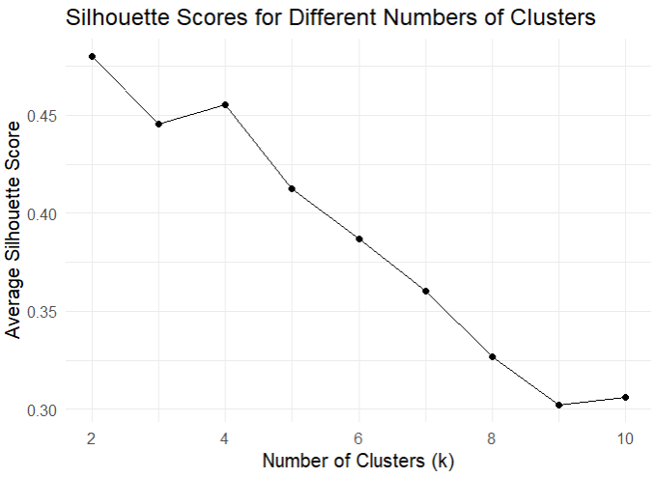
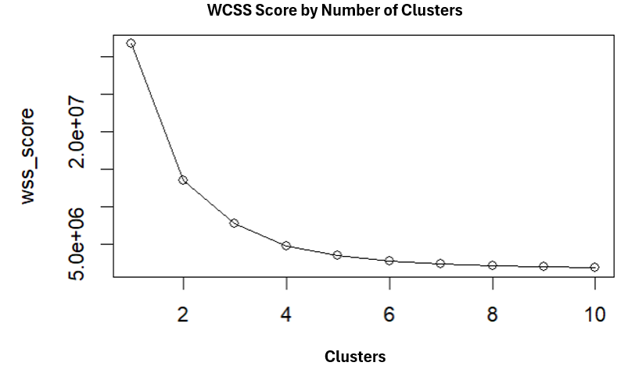
Cluster count
WCSS by Number of Clusters
Notes:
For the cluster analysis, I used both the silhouette score and the within cluster separation score to determine the ideal number of clusters. The silhouette score clearly identified 4 clusters to be ideal, while the within cluster separation also identified 4 less conclusively. The elbow value is typically used when looking at the within cluster separation score and to me 4 looked like the best choice, but 3 could be used too according to the within cluster separation. Since both identified 4, I went with 4.

Slide 10
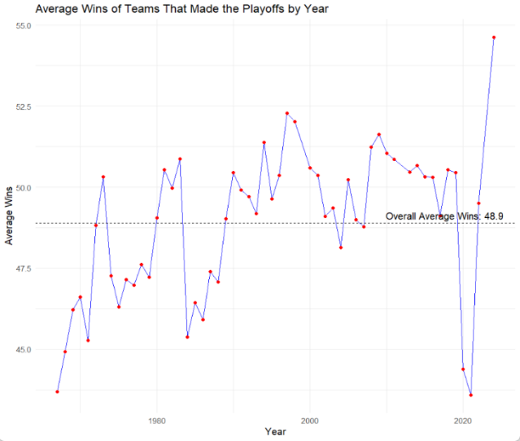
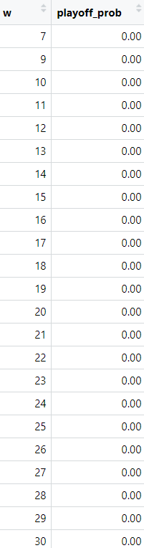
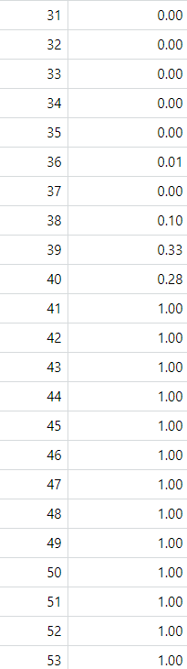
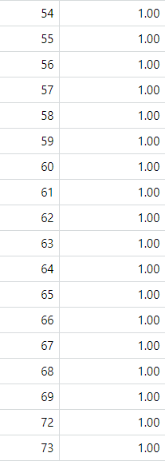
Playoff guarantee descriptive statistic visualizations
Notes:
Some of my descriptive modeling identified 42 and 50 wins to be ideal targets for playoff appearance. The graph on the left shows the average wins for playoff teams over the team, with the overall average at 48.9. On the right are the results from a basic random forest model using wins to predict playoff appearance. The model identified 41 in an almost binary classification. For more insulation on these values, I increased each by 1 hence 42 and 50.

Slide 11
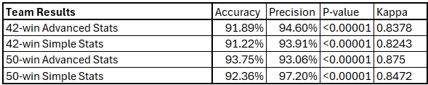
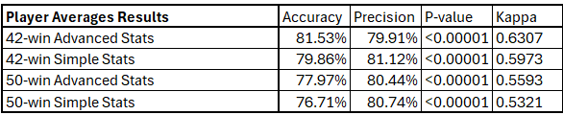
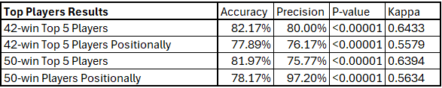
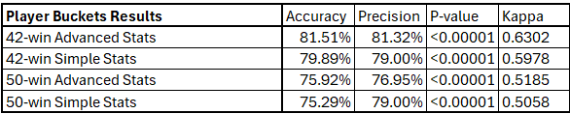
modeling results
Notes:
Here are the results of my predictive modeling. From left to right, the tables are team results, player average results, top player results and player buckets results. Looking at the accuracy metrics, it can be seen while the advanced stats yielded a higher accuracy than the simple stats, typically the simple stats achieved a higher precision than the advanced stats. Additionally, the 42 win threshold is easier to predict against in all cases except using team data. Finally, the results using the top players outperformed the original player results showing that modeling only using the most impactful players yields an increased accuracy.

Slide 12
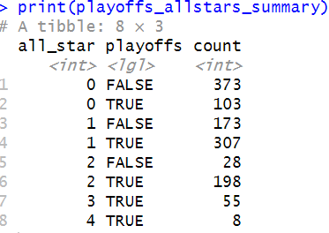
All-star impact
To determine the impact of all-stars on playoff appearance, I determined a count of playoff appearances by all star count:
All-star count ranges from 0-4
Teams with 1+ all-stars reach the playoffs 75% of the time
Teams with 2+ all-stars reach the playoffs 95% of the time
Clearly, all-stars are integral to playoff appearance
Notes:
To briefly explain the illustrate all-stars have on making the playoffs, I created a count of playoff appearances by the count of all-stars. The count ranged from 0 to 4, and the results show the clear importance of all-stars. Having one or more all-star on a team resulted in a playoff appearance 75% of the time, while 2 or more all-stars led to a playoff appearance 95% of the time. These findings were even more conclusive than I could have imagined, and proved without a doubt that all-stars contribute significantly to playoff appearance.

Slide 13
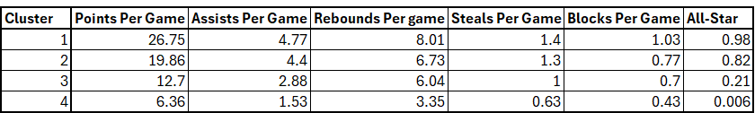
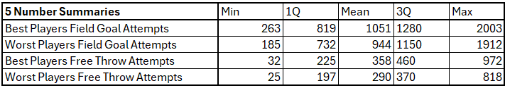
clustering Results & best vs worst
Notes:
Examining the results from the cluster analysis shows an interesting result. There are two distinct clusters with a high makeup of all-stars. This can be extrapolated to create a tentative
Template for all star selection. Based on the results above, it seems that averaging a minimum total of 30 points, rebounds, and assists per game is mandatory. Something else the clustering clued me in on was the disparity in shot attempts between the players on the best and worst teams. Players from the best teams average over 100 more attempts a season and over 50 more freethrows a season showing the pace may be the downfall of the bad teams.

Slide 14
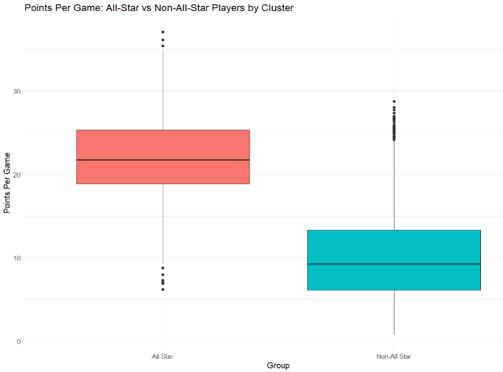
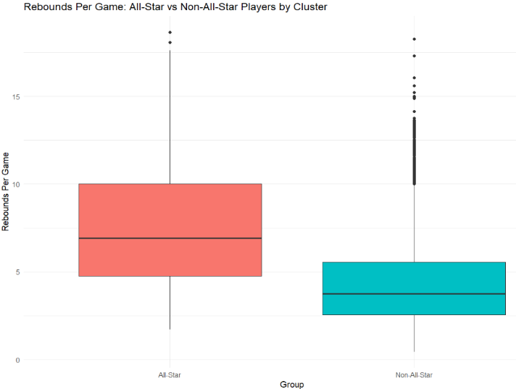
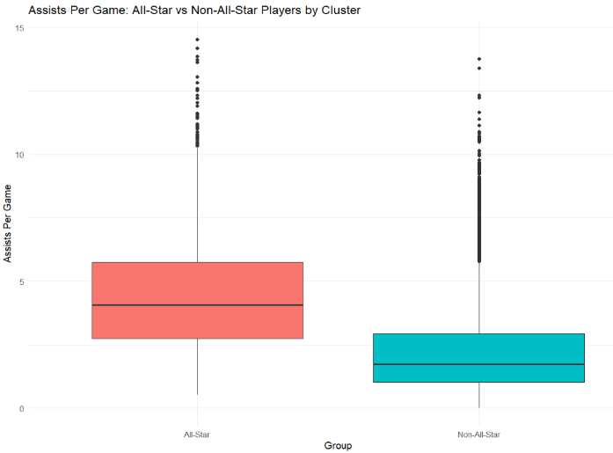
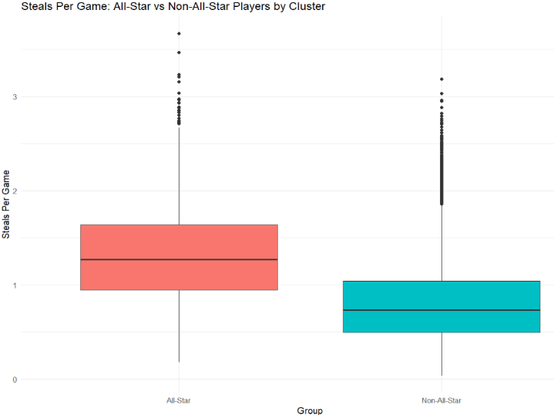
All-star cluster distributions
Below are boxplots showing the distribution of values within each cluster. The red boxes represent the all-star cluster, while the blue boxes represent the non-all-star cluster
Points: Rebounds: Assists: Steals:
Notes:
The boxplots here show the distribution of various stats by cluster. The red clusters represent all-stars, while the blue are non all stars. As you can see, all stars massively outperform non all stars in points, and show a significant difference in rebounds, assists, and steals, as well. The distribution of blocks was more similar, which is why the plot was not included. Each plot has a number of outliers showing that while non-all-stars can record stats similar to all-stars, for the most part they really don’t. Additionally it is important to remember that players who played less than the average for minutes played were removed earlier in my analysis, so the non-all-star dataset is not skewed by players who essentially played 0 minutes.

Slide 15
conclusions
50 wins should be the target for all team in order to reach the playoffs. 42 wins could be a less ambitious goal.
Upon introducing a binary threshold, win total can be predicted
Team stats result in a higher accuracy
42-win threshold results in a higher accuracy
Including only top 5 players by minutes played results in a higher accuracy
Simple statistics drive the predictions
Best predictors:
Team: per game averages, shooting percentages and attempts, age, all-star count
Player: per game averages, turnover count, shooting percentages, age, experience
All-stars have a major impact on playoff appearance making them extremely valuable
Notes:
To summarize all of my findings, I will start with the most important. It is very clear 50 wins is indicative of making the playoffs. This should be the goal for all teams. Next, upon introducing a binary threshold and refining features, win total can be predicted with a high degree of accuracy. All team models exceeded 90% accuracy. If player data is used, it should ideally be limited to the 5 players who played the most minutes. Additionally, the simple stats drive the predictions, as the accuracy remained constant and precision increased with simple stats. Finally, all-stars should be coveted as their value cannot be overstated.

Slide 16
Application
Imports the data from JSON file
Calculates historical playoff likelihood using user input
Removes features before analysis
Adjusts response to binary
Standardizes class
Predicts teams above the threshold for the selected year

Slide 17
Citations
Releases, Forbes Press. “Forbes Releases 2013 NBA Team Valuations.” Forbes, Forbes Magazine, 21 June 2013, www.forbes.com/sites/forbespr/2013/01/23/forbes-releases-2013-nba-team-valuations/.
“Golden State Warriors on the Forbes NBA Team Valuations List.” Forbes, Forbes Magazine, www.forbes.com/teams/golden-state-warriors/. Accessed 25 Nov. 2024.
Spotrac. “2024 NBA Rankings.” Spotrac.Com, www.spotrac.com/nba/rankings/_/year/2024. Accessed 30 Nov. 2024.
Datta, Sumitro. “NBA Stats (1947-Present).” Kaggle, 1 Nov. 2024, www.kaggle.com/datasets/sumitrodatta/nba-aba-baa-stats?select=Team%2BStats%2BPer%2BGame.csv.
Reason source
Zafar, Aqsa. “K Means Clustering Algorithm: Complete Guide in Simple Words.” MLTut, 8 Jan. 2024, www.mltut.com/k-means-clustering-algorithm-complete-guide-in-simple-words/.
Raafat, Ahmed. “Decision Trees and Random Forests, All You Need to Know.” Machine Learning Archive, 8 Apr. 2023, mlarchive.com/machine-learning/decision-trees-and-random-forest-all-you-need-to-know/.
“Forbes List of the Most Valuable NBA Clubs.” Wikipedia, Wikimedia Foundation, 18 Nov. 2024, en.wikipedia.org/wiki/Forbes_list_of_the_most_valuable_NBA_clubs#Historical_valuations.
50

